Slide 1
Interface Technologies
That Have Not Yet Left The Lab
Johnny Lee
Google

Slide 2
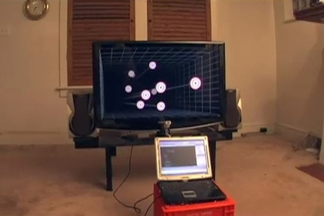


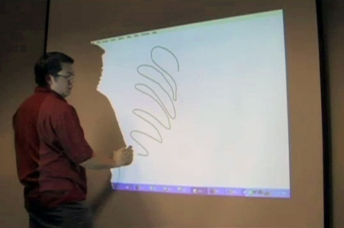

PhD, Human-Computer Interaction

Slide 3
time
research
commercial product

Slide 4
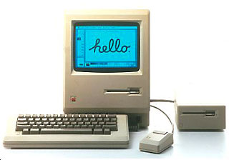
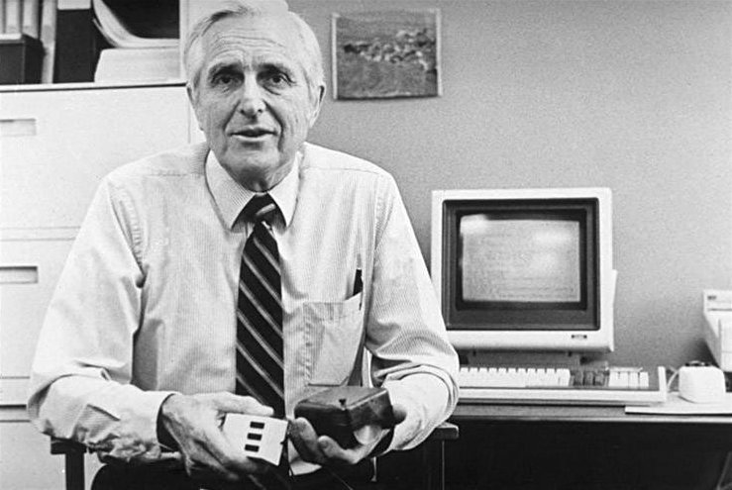
Mouse
17 Years
Douglas Englebart, 1967
Macintosh, 1984

Slide 5
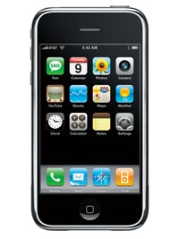
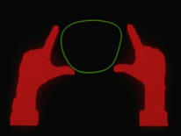
Multi-touch
24 Years
Myron Krueger, 1983
iPhone, 2007

Slide 6
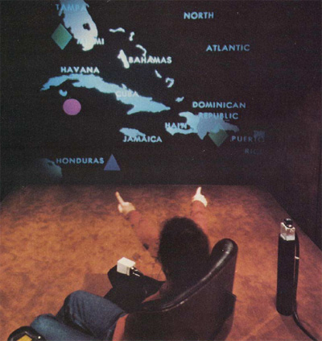
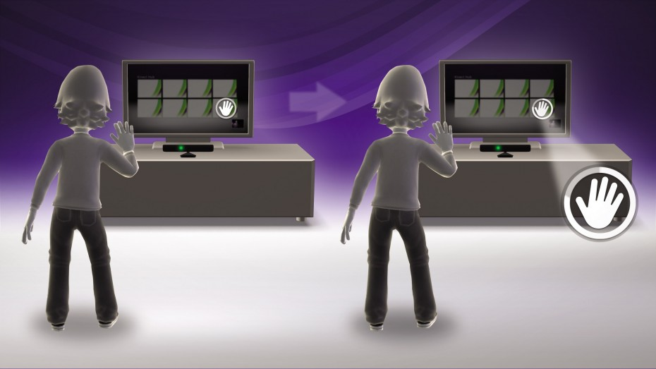
Gesture Interfaces
30 Years
Richard Bolt, 1980
Kinect, 2010

Slide 7
concepts - old
selection & execution - new

Slide 8
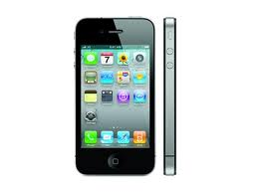
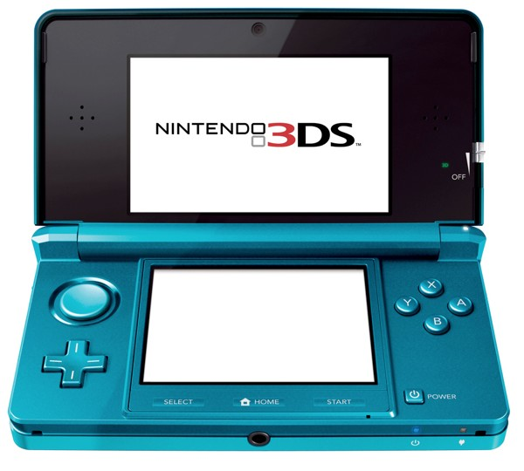
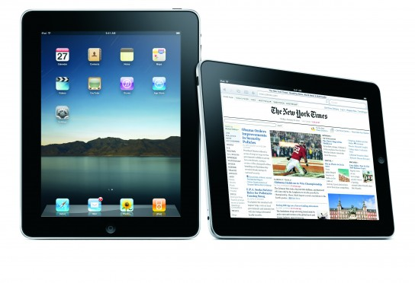
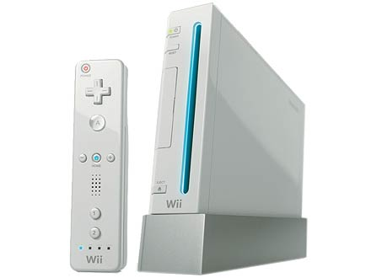
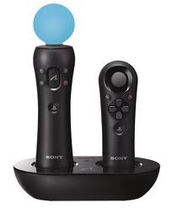
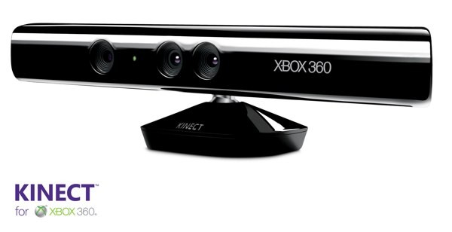
Race for:
Interface/Interaction designs
Sensor technologies
Display Technologies
Recognition Algorithms
Race for the Fastest
Computer Ended

Slide 9
no shortage of ambition or imagination

Slide 10
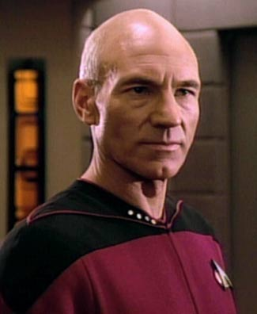
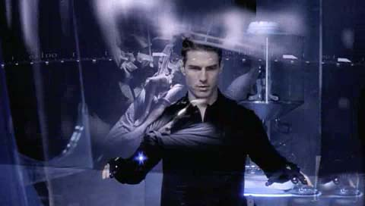
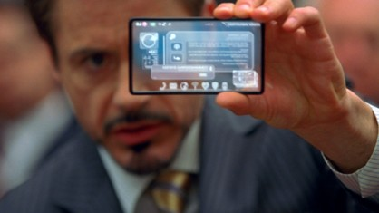

Slide 11
“Where is my flying car?”

Slide 12
light of day
brilliant
interface
ideas
> 1000 developers
“commercial success”

Slide 13
But, why?

Slide 15
“I want my flying car.”

Slide 16
Top 8 Reasons
Why Your Great Interface Technology Idea Might Die:

Slide 17
Top 8 Reasons Why Your Great Interface Technology Idea Might Die:
1. Does it work as well as you dreamt it would?
“I don’t know, it doesn’t exist yet”
Go build it. If you can’t build it find someone who can. Then, come back.
“Yes (or well enough)”
continue…

Slide 18
Top 8 Reasons Why Your Great Interface Technology Idea Might Die:
2. Does it work robustly for enough naïve users?
“No, but it works well for me.”
Congratulations, you can sell 1 unit.
“Yes (or enough to make money)”
continue…

Slide 19
Top 8 Reasons Why Your Great Interface Technology Idea Might Die:
3. Can it be manufactured cheaply AND reliably
AND stand up to years of consumer abuse?
“I can get 2 out of 3.”
Sorry, please try again soon.
“Yes”
continue…

Slide 20
Top 8 Reasons Why Your Great Interface Technology Idea Might Die:
4. Sadly, most normal people just surf the web, check/send messages, and play games.
Does it improve any of those activities?
“No, but it will let them do something awesome”
First, convince the masses to want to do something more interesting with their computers, or settle on a niche/professional market.
“Yes”
continue…

Slide 21
Top 8 Reasons Why Your Great Interface Technology Idea Might Die:
5. Does this require an ecosystem assumption like other devices, critical mass, or infrastructure changes?
“Yes… or maybe”
This either:
significantly reduces your addressable audience, or significantly increases the wholistic investment risk.
“No”
continue…

Slide 22
Top 8 Reasons Why Your Great Interface Technology Idea Might Die:
6. No third party developers are going to write software for your tiny platform, and retro-fitting old software is usually a disaster.
“It will be so awesome, developers will work for no money.”
Good luck.
“I will write all the software myself.”
“I will make it irresistibly big to begin with.”
You have deep pockets. continue…

Slide 23
Top 8 Reasons Why Your Great Interface Technology Idea Might Die:
7. Does executive leadership see the potential money
and believe the organization can execute it well?
“Yes”
continue…
“No”
Are you really sure there really is money to be made and that your organization would not screw it up?
“No”
Thanks for playing.
“Yes”
Find a good salesman. They are annoyingly important to getting things done.

Slide 24
Top 8 Reasons Why Your Great Interface Technology Idea Might Die:
8. Is it ahead of it’s time? Some things just are. For example, the mouse, multi-touch, and gesture input.
“I don’t know.”
I don’t know either. But if it is, might get some good buzz, sell to some early adopters, and you’ll have a great story about how you did “that” 10 years ago.
In the mean time, here are a few interesting projects that have failed to leave the prototype stage for one of the aforementioned reasons:

Slide 25
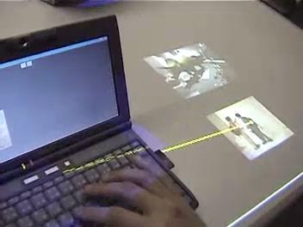
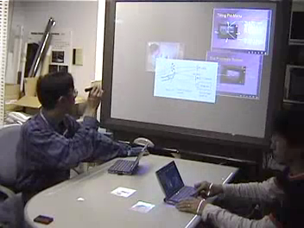
Augmented Workbench, 1999
[link]

Slide 26
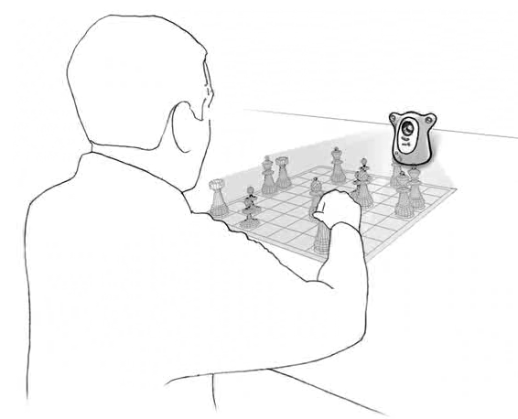
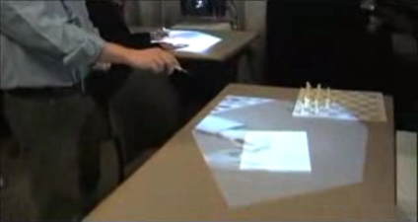
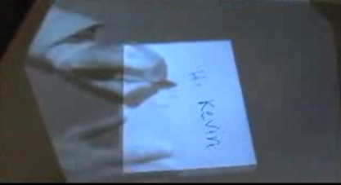
Play Together – Wilson, MSR - 2002
Play Anywhere, 2005– MSR

Slide 27
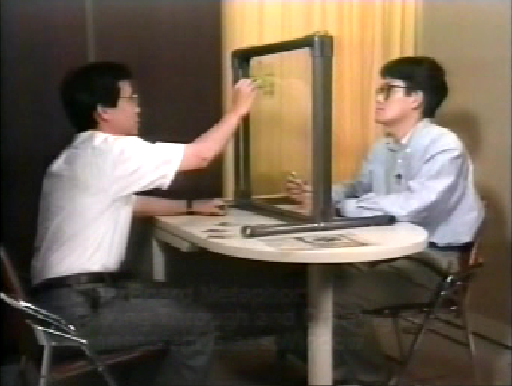
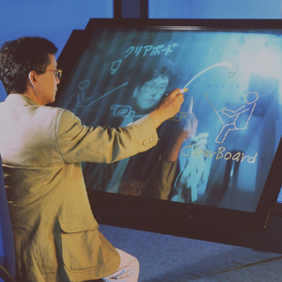
ClearBoard – 1992, Ishii

Slide 28
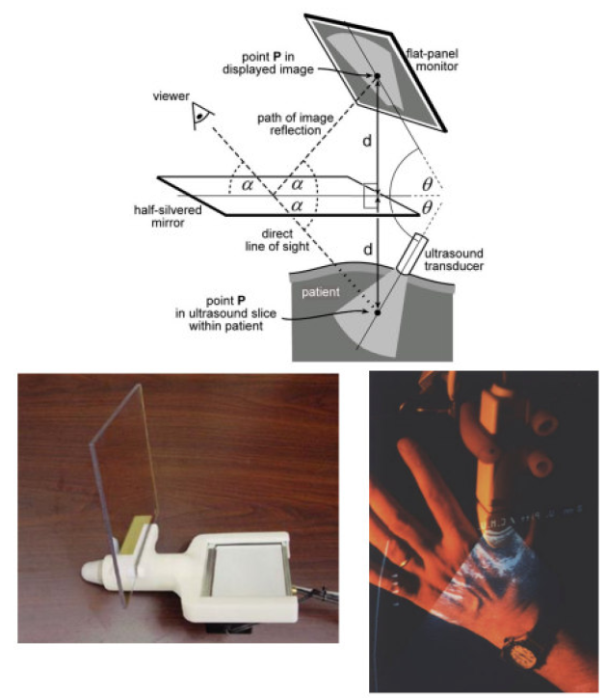
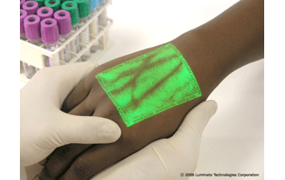
Real Time Tomographic Reflection: Phantoms for Calibration and Biopsy, 2001.

Slide 29
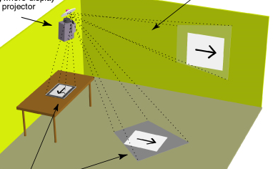
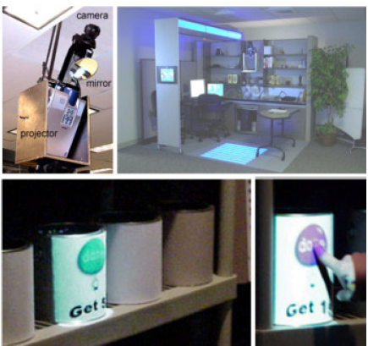
Pinhanez, C. The everywhere displays projector: A device to create ubiquitous graphical interfaces, In proceedings of Ubiquitous Computing, pp. 315-331, 2001.

Slide 30
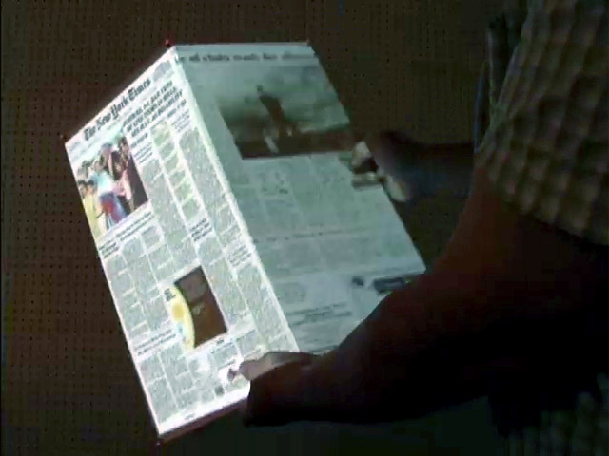
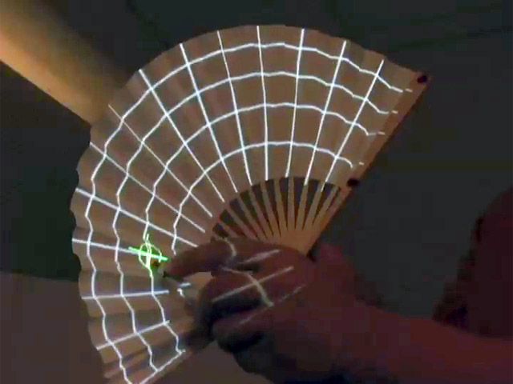
Foldable Interactive Displays
[link]

Slide 31
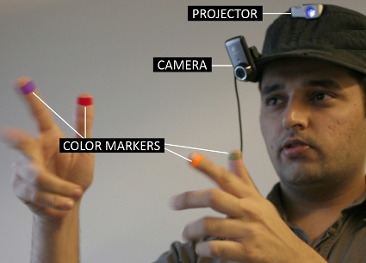
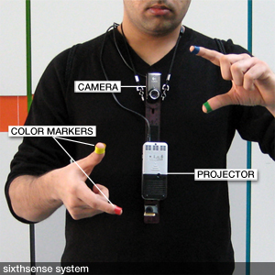
Sixth Sense, MIT, 2008
[link]

Slide 32
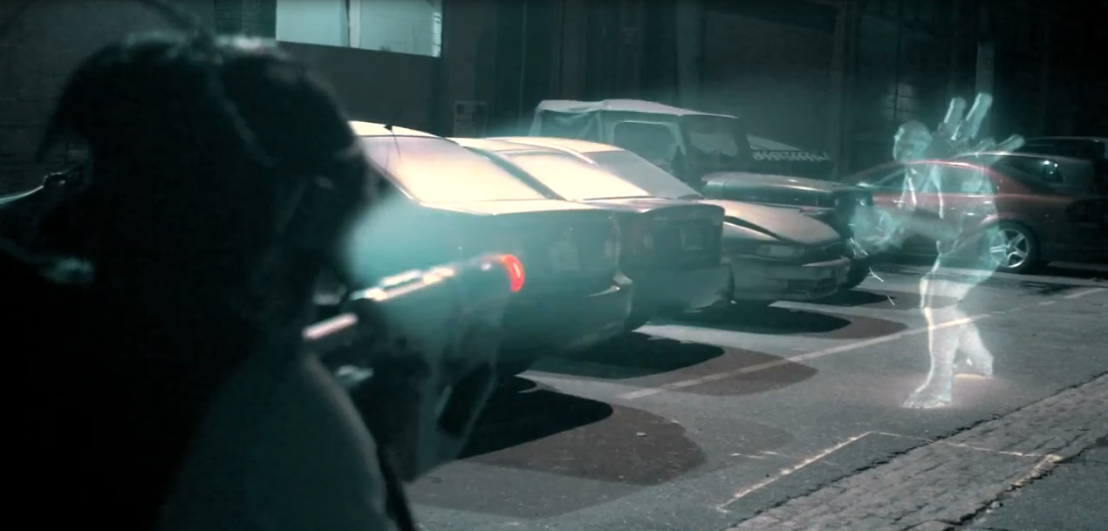
Feddie Wong, Future of Motion Gaming

Slide 33
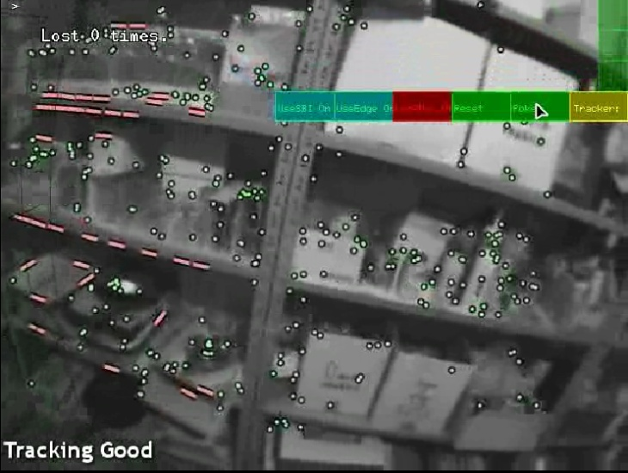
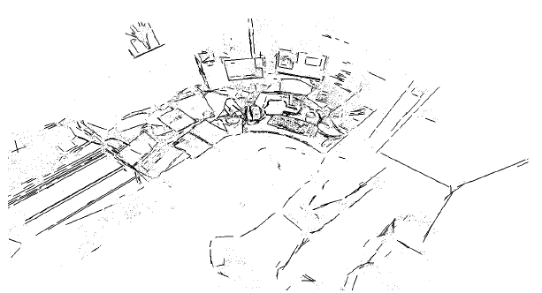
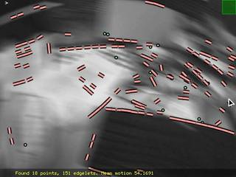
Keyframe Based SLAM, George Klien, 2008

Slide 34
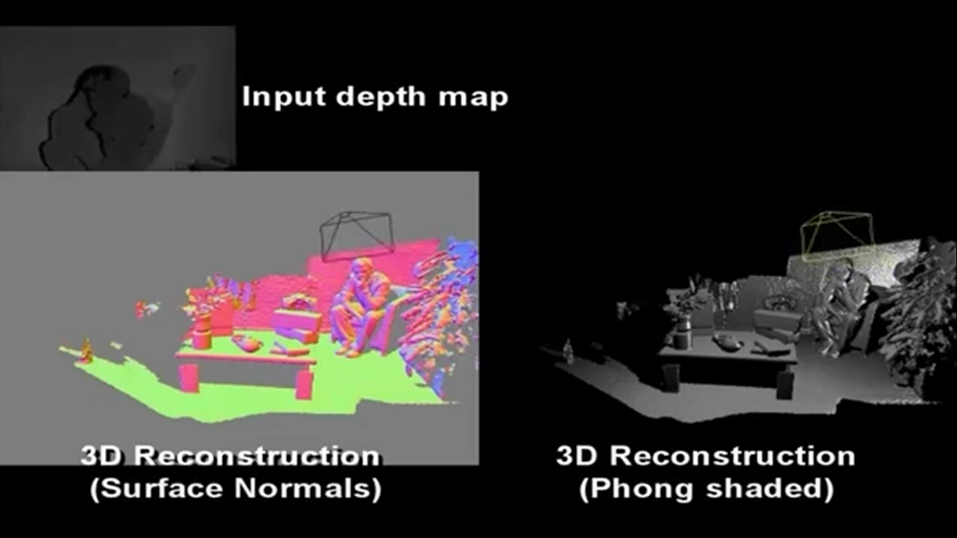
Kinect Fusion, MSR

Slide 35
Display Technologies

Slide 36
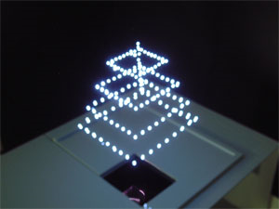
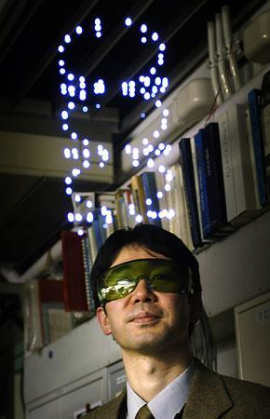
3D plasma imager, AIST, 2006
[link]

Slide 37
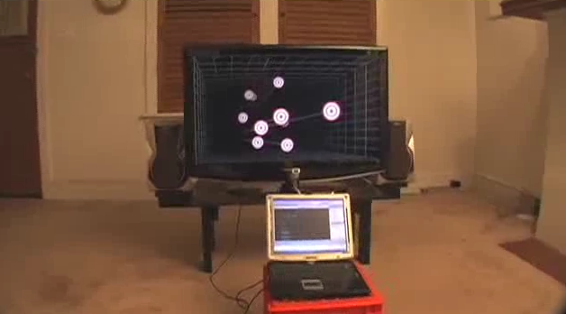

Slide 39
4D Light field Display

Slide 40
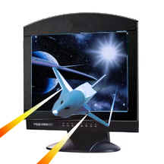
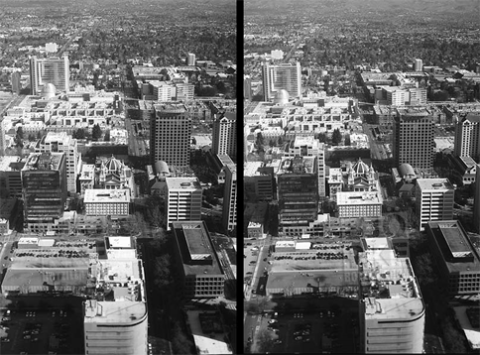
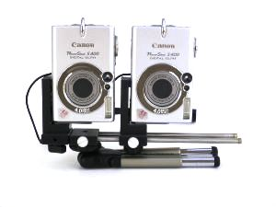

Slide 41
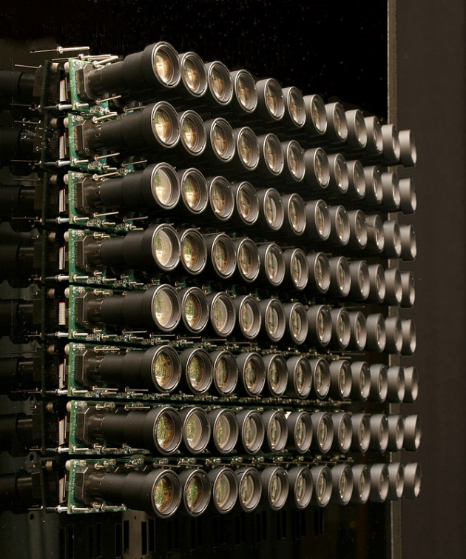
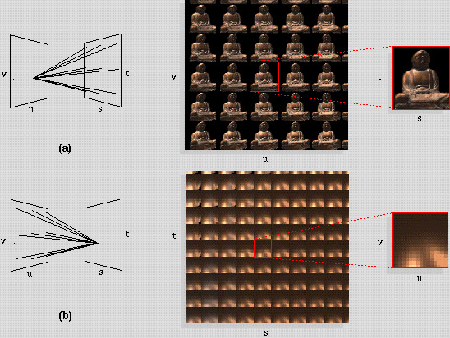
Light Field Capture (Computational Photography)
[link]

Slide 42




Slide 43
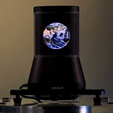
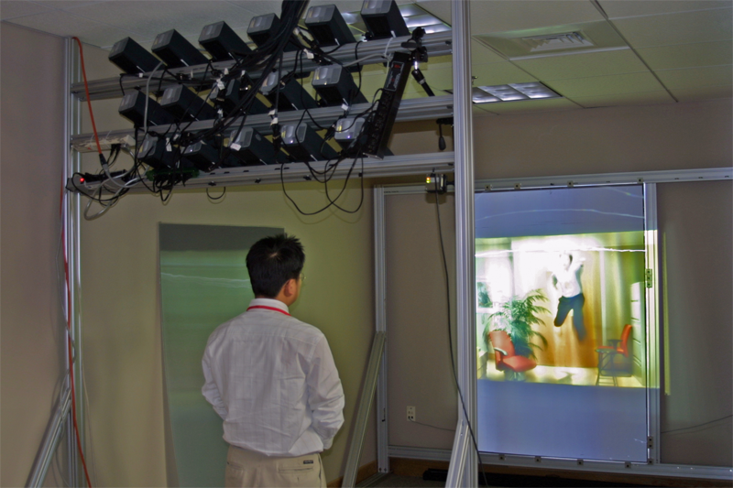
Lightfield Displays
No glasses - auto stereo 3D
No sweet spot – motion parallax
Multiple Simultaneous users – perspective correct

Slide 44
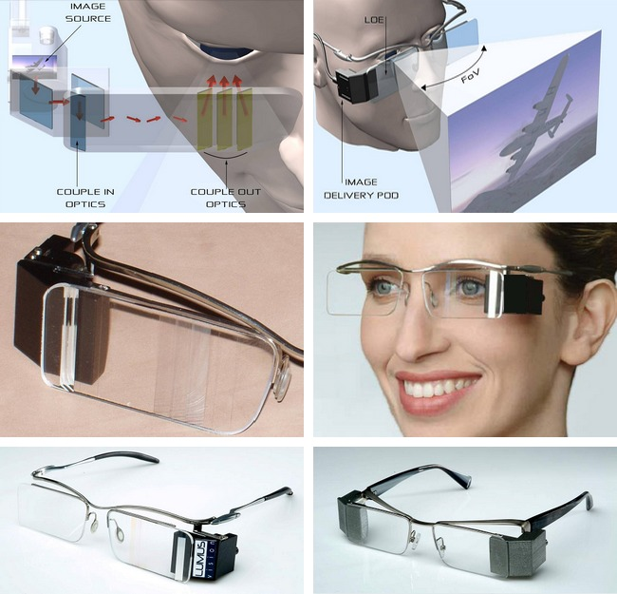

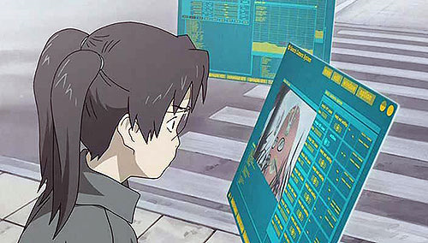
Lumus, Ltd
[link]
Dennou Coil, Mad House

Slide 45
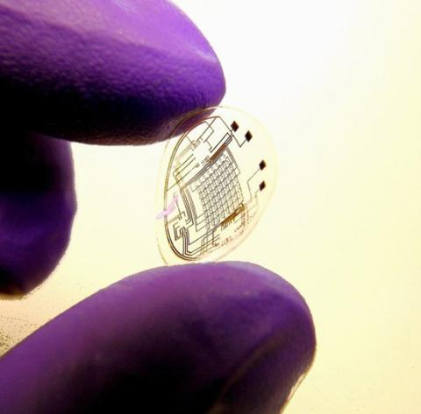

Electronic Contact Lens, University of Washington

Slide 46
Sensing Technologies

Slide 47




Sensitive Object, 2008
[link]

Slide 48








Technology for Long-Term Health Care, Intel Research

Slide 49




powerline noise
water line noise
location from power lines/HVAC
thermal sensing for interaction
Ubicomp Lab, University of Washington

Slide 50



Forearm Electromyography for Muscle-Computer Interfaces, University of Washington

Slide 51


Using a Low-Cost Electroencephalograph for Task Classification in HCI Research
[link]

Slide 52
human as a sensor

Slide 53



Slide 54


Slide 55
“These are neat, but…..”
“Where are my flying cars?”
“When are we going to replace the mouse and keyboard?”

Slide 56

Touch/Stylus
Mouse + Keyboard
Motion / Remotes

Slide 57
Mouse
Keyboard

Slide 58







Slide 59







Slide 60
capture intent
does not come for free

Slide 61

All Possible User Scenarios

Slide 62
broad reaching new
interface technology is a myth
(as I’ll elaborate in my keynote later today)
Johnny Lee
johnnylee@google.com

Slide 65
era of specialization
era of divergence
good hw/sw/ux design

